Slide 1
GENAI DEVELOPER GCP BRIGHTSPEED
GCP

Slide 2
Google Cloud Platform (GCP) - Foundations
Ref: https://code.visualstudio.com/docs/python/python-tutorial#_create-a-virtual-environment

Slide 3
GCP Introduction
What is Cloud Computing
Basically using someone else’s computer over the internet
Examples- GCP, AWS, IBM Cloud, etc.
Some interesting features of cloud computing are as follows:
You get computing resources on-demand and self-service
The customer has to use a simple User Interface and they get the computing power, storage requirements, and network you need, without human intervention
Access these cloud resources over the internet from anywhere on the globe
The provider of these resources has a huge collection of these resources and allocates them to customers out of that collection
The resources are elastic
If you need more resources you can get more, rapidly
If you need less, you can scale down back
The customers pay only for what they use or reserve
If they stop using resources, they stop paying
What is Google Cloud Platform(GCP)?
Starting from 1998 with the launch of Google Search. google has developed one of the largest and most powerful IT Infrastructures in the world
Today, this infrastructure is used by billions of users to use services such as Gmail, YouTube, Google Photos, and Maps
In 2008, Google decided to open its network and IT infrastructure to business customers, taking an infrastructure that was initially developed for consumers’ applications to public service and launching the Google Cloud platform
All the services listed in (Cloud Computing) above are provided by Google hence the name Google Cloud Platform (GCP)
Regions and zones
Let’s start at the finest grain level (i.e. the smallest or first step in the hierarchy), the Zone. A zone is an area where Google Cloud Platform Resources like virtual machines or storage are deployed.
Ref: https://www.geeksforgeeks.org/what-is-google-cloud-platform-gcp/?ref=lbp

Slide 4
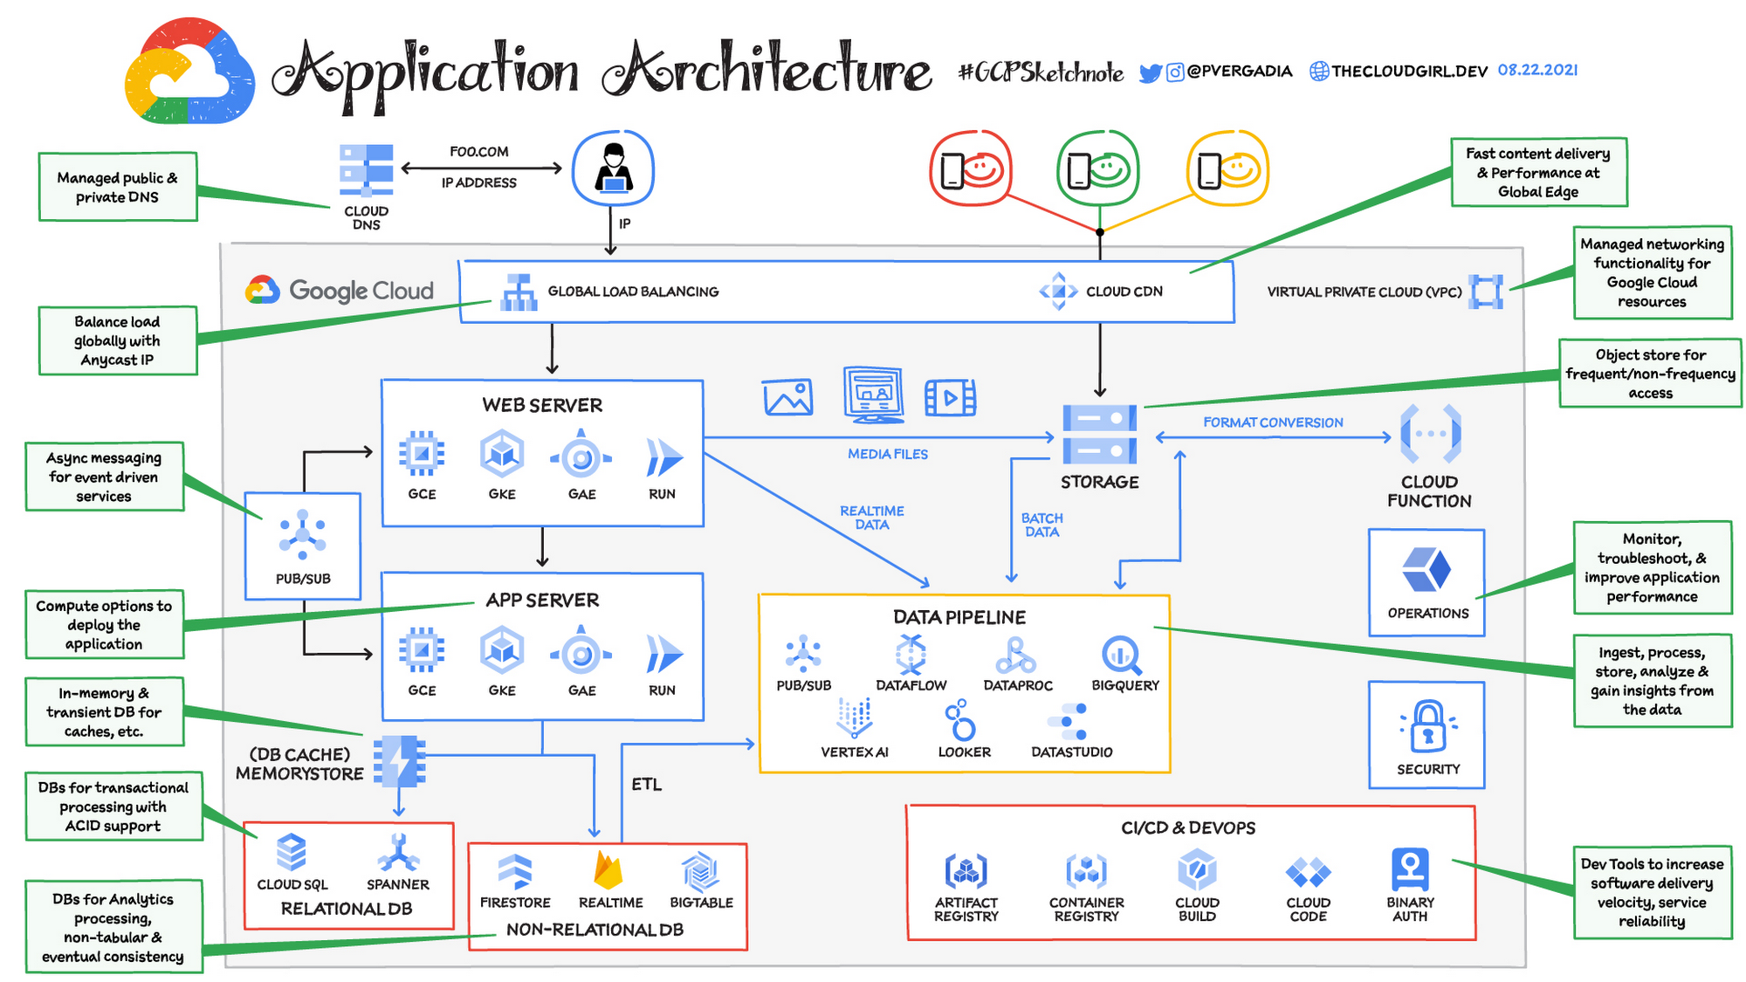
Benefits Of Using Google Cloud Platform
Scalability and flexibility:
You can scale the servers based up on the load if there is high incoming traffic then you can scale up and if the traffic is less then you can scale down which make it flexible and mostly suited for the business use cases
Cost-effectiveness:
Google Cloud Platform follows the pay-as-you-go model which it will charge only for the how much time you use service and at level you are going to use the services
High performance:
You can highly reliable on the infrastructure of the google cloud because they are highly available and spread across the multiple regions around the world
Security:
Google Cloud Platform is more secure you can trust the service offered by the gcp for the security options such as encryption, access control, and data loss prevention
Fig: Sample website (foo.com) Application Architecture leveraging GCP
Ref: https://docs.astronomer.io/learn/what-is-an-operator=

Slide 5
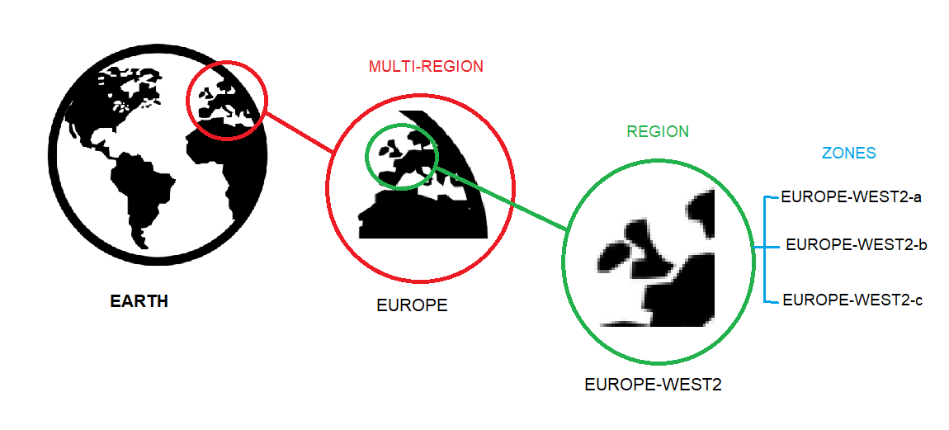
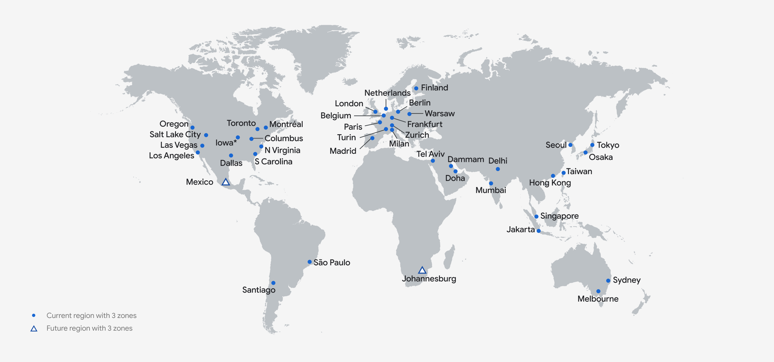
GCP Regions and Availability Zones
Regions and zones
Let’s start at the finest grain level (i.e. the smallest or first step in the hierarchy), the Zone.
A zone is an area where Google Cloud Platform Resources like virtual machines or storage are deployed
For example, when you launch a virtual machine in GCP using Compute Engine, it runs in a zone you specify (suppose Europe-west2-a)
Although people consider a zone as being sort of a GCP Data Center, that’s not strictly accurate because a zone doesn’t always correspond to one physical building
Regions: Zones are grouped into regions which are independent geographic areas and much larger than zones (for example- all zones shown above are grouped into a single region Europe-west2) and you can choose what regions you want your GCP resources to be placed in
All the zones within a neighborhood have fast network connectivity among them
Locations within regions usually have trip network latencies of under five milliseconds
As a part of developing a fault-tolerant application, you’ll need to spread your resources across multiple zones in a region
That helps protect against unexpected failures
You can run resources in different regions too
Lots of GCP customers do this, both to bring their applications closer to users around the world, and also to guard against the loss of a whole region, say, due to a natural disaster
Multi-Region:
A few GCP Services supports deploying resources in what we call a Multi-Region
For example, Google Cloud Storage, lets you place data within the Europe Multi-Region
What that means is that it is stored redundantly in a minimum of two different geographic locations, separated by at least 160 kilometers within Europe
GCP currently has 39 regions
For more details please refer:
https://cloud.google.com/about/locations
Ref: https://docs.astronomer.io/learn/what-is-an-operator=

Slide 6
Common GCP Services
Compute
Compute Engine: It is used to provision the virtual machine machines to deploy the application with the need of your required ram,rom and security groups.
Google Kubernetes Engine(GKE): Google cloud provide kubernetes(GKE) as an service where you can deploy the application and restof the things like autoscaling and load balancing will be taken care by the google cloud.
App Engine: A scalable runtime environment, Google App Engine is mostly used to run Web applications. These dynamic scales as demand change over time because of Google’s vast computing infrastructure. Because it offers a secure execution environment in addition to a number of services, App Engine makes it easier to develop scalable and high-performance Web apps.
Storage
Cloud Storage: You can store the data which is required to be highly available and which is in large amount.
Persistent Disk: Presistent disk is an storage disk which can be attached to the virtual machine and can be reused for the another virtual machine.
Cloud SQL: Cloud SQL is an fully managed service by the google cloud platform and it offers services like MySQL, PostgreSQL and SQL Server.
Networking
Virtual Private Cloud (VPC): You can deploy your application in the private network which can be achieved by the google cloud.
Cloud Load Balancing: This is most important service in the google cloud which is used to distribute the cloud across the multiple replicas of the applications.
Cloud CDN: This is the service which will cache the content and delivers to the end users with the help of edge locations.
Data analytics
Bigquery: All organizations look for unlocking business insights from their data. But it can be hard to scalably ingest, store, and analyze that data as it rapidly grows. Google’s enterprise data warehouse called BigQuery, was designed to make large-scale data analysis accessible to everyone.
Dataflow: It is the analysis of flow of data in control flow graph, i.e., the analysis that determines the information regarding the definition and use of data in program. With the help of this analysis, optimization can be done.
Pub/Sub: Pub/sub Consider a scenario of synchronous message passing. You have two components in your system that communicate with each other. LeLet’ss call the sender and receiver. The receiver asks for a service from the sender and the sender serves the request and waits for an acknowledgment from the receiver. There is another receiver that requests a service from the sender. The sender is blocked since it hasn’t yet received any acknowledgment from the first receiver. The sender isn’t able to serve the second receiver which can create problems. To solve this drawback, the Pub-Sub model was introduced.
Machine learning
Vertex AI Platform: As we know Artificial Intelligence (AI) has undergone advancements throughout the years leading to a transformation of industries and reshaping how businesses operate. The emergence of cloud-based AI platforms has further accelerated this revolution enabling organizations to leverage the potential of AI.
AI Platform Training: You can train the AI model with the help of AI Platform Training in google cloud.
AI Platform Prediction: You can make the predictions by using the your machine learning models.
Productivity and collaboration
Google Workspace: Most of us are familiar with various Google Workspace products(also called G Suite) like Calendar, Drive, and Gmail, etc.
Cloud Identity and Access Management (IAM): Identity Access Management is used by the root user (administrator) of the organization. The users represent one person within the organization, and the users can be grouped in that all the users will have the same privileges to the services.
Note: For detailed list of services please refer: https://cloud.google.com/terms/services; https://googlecloudcheatsheet.withgoogle.com/
Ref: https://docs.astronomer.io/learn/what-is-an-operator=

Slide 7
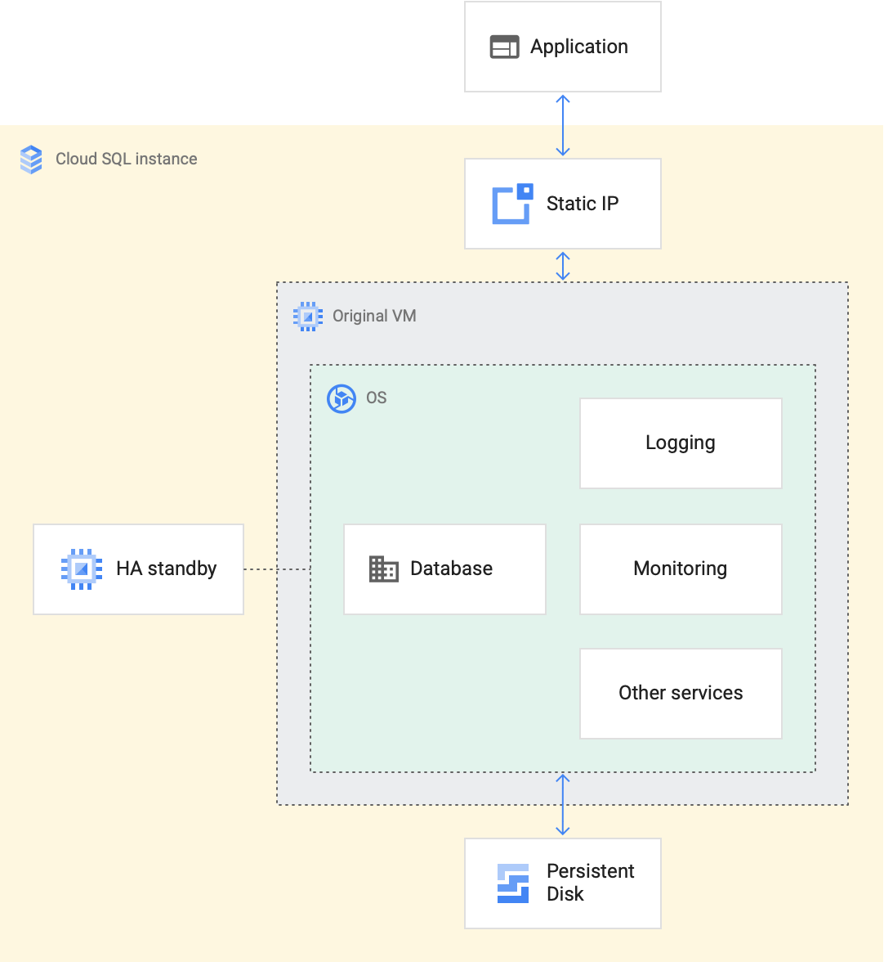
GCP Cloud SQL
Cloud SQL
Fully managed relational database service for MySQL, PostgreSQL, and SQL Server
This frees you from database administration tasks so that you have more time to manage your data
Use cases for Cloud SQL
Cloud SQL provides a cloud-based alternative to local MySQL, PostgreSQL, and SQL Server databases
You should use Cloud SQL if you want to spend less time managing your database and more time using it
Many applications running on Compute Engine, App Engine and other services in Google Cloud use Cloud SQL for database storage
What Cloud SQL provides
Cloud SQL offers many services so you don't have to build and maintain them yourself. You can focus on your data and let Cloud SQL handle the following operations:
Backups
High availability and failover
Network connectivity
Export and import
Maintenance and updates
Monitoring
Logging
What is a Cloud SQL instance?
Each Cloud SQL instance is powered by a virtual machine (VM) running on a host Google Cloud server
Each VM operates the database program, such as MySQL Server, PostgreSQL, or SQL Server, and service agents that provide supporting services, such as logging and monitoring
The high availability option also provides a standby VM in another zone with a configuration that's identical to the primary VM
The database is stored on a scalable, durable network storage device called a persistent disk that attaches to the VM
A static IP address sits in front of each VM to ensure that the IP address an application connects to persists throughout the lifetime of the Cloud SQL instance
Fig: Cloud SQL instance overview:
Ref: https://cloud.google.com/sql?hl=en; https://www.youtube.com/watch?v=ZMQ2n6i-7jw; https://cloud.google.com/sql/docs/introduction; https://www.youtube.com/watch?v=q6noaMAnk5s;

Slide 8
GCP Cloud SQL
Database administration
Cloud SQL lets you create and delete databases and database users, but it isn't a database administration tool
There are many database administration tools you can choose from, depending on your database engine, including the following:
phpMyAdmin for MySQL
MySQL Workbench for MySQL
Toad Edge for MySQL and PostgreSQL
pgAdmin.org for PostgreSQL
SQL Server Management Studio for SQL Server
Visual Studio Code for SQL Server
Cloud SQL pricing
Cloud SQL pricing varies with your configuration settings, and depends on:
How much storage you provision, in GiB per month
How many CPUs you select for your Cloud SQL instance
How much memory you select for your Cloud SQL instance
Where you choose to host your data
How much network traffic leaves your instance
How many IP addresses you assign and use
Connect to a Cloud SQL managed database
Connecting to a Cloud SQL managed database is similar to connecting to a self-managed database
Depending on how you configure it, your Cloud SQL instance has a public IP address (which can be accessed from outside of Google Cloud, using the internet), or a private IP address (which can only be accessed through a Virtual Private Cloud (VPC) network)
In addition, Cloud SQL provides different authorization options to control who is allowed to connect to your instance, such as the Cloud SQL Auth Proxy
Cloud SQL updates
Over the life of a Cloud SQL instance, two kinds of updates can occur:
Configuration updates, which are done by the user.
System updates, which are performed by Cloud SQL
Configuration updates
As your database's usage grows and new workloads are added, you might want to update your database configuration to adapt accordingly. Configuration updates include:
Increasing compute resources
Modifying a database flag
Enabling high availability
System updates
Keeping the database instance up and running requires operational effort beyond configuration updates. Servers and disks need to be replaced and upgraded. Operating systems need to be patched as new vulnerabilities are discovered. Database programs need to be upgraded as the database software provider releases new features and fixes new issues. Normally, a database administrator performs each of these updates regularly in order to ensure their systems stay reliable, protected, and up-to-date. Cloud SQL attends to these regular system updates for you, so you can spend less time managing your database and more time developing great applications.
The process Cloud SQL uses to perform system updates varies based on which part of the system is getting updated. In general, Cloud SQL system updates are divided into three categories: hardware updates, online updates, and maintenance.
Hardware updates improve the physical infrastructure, such as swapping out a defective machine host or replacing an old disk. Google Cloud performs hardware updates without interruption to your application. For example, when updating a database server, Google Cloud uses live migration, an advanced technology that reliably migrates a VM from the original host to a new one while the VM stays running.
Online updates enhance the software of the supporting service agents that sit adjacent to the database program on the VM. These updates are performed while the database is up and running, serving traffic. Online updates do not cause downtime for your application.
Maintenance updates apply upgrades to the operating system and the database program. Because these updates require an instance restart, they incur some downtime. For this reason, Cloud SQL lets you schedule maintenance to occur at a time that is the least disruptive to your application.
Ref: https://cloud.google.com/sql?hl=en; https://www.youtube.com/watch?v=ZMQ2n6i-7jw; https://cloud.google.com/sql/docs/introduction; https://www.youtube.com/watch?v=q6noaMAnk5s;

Slide 9
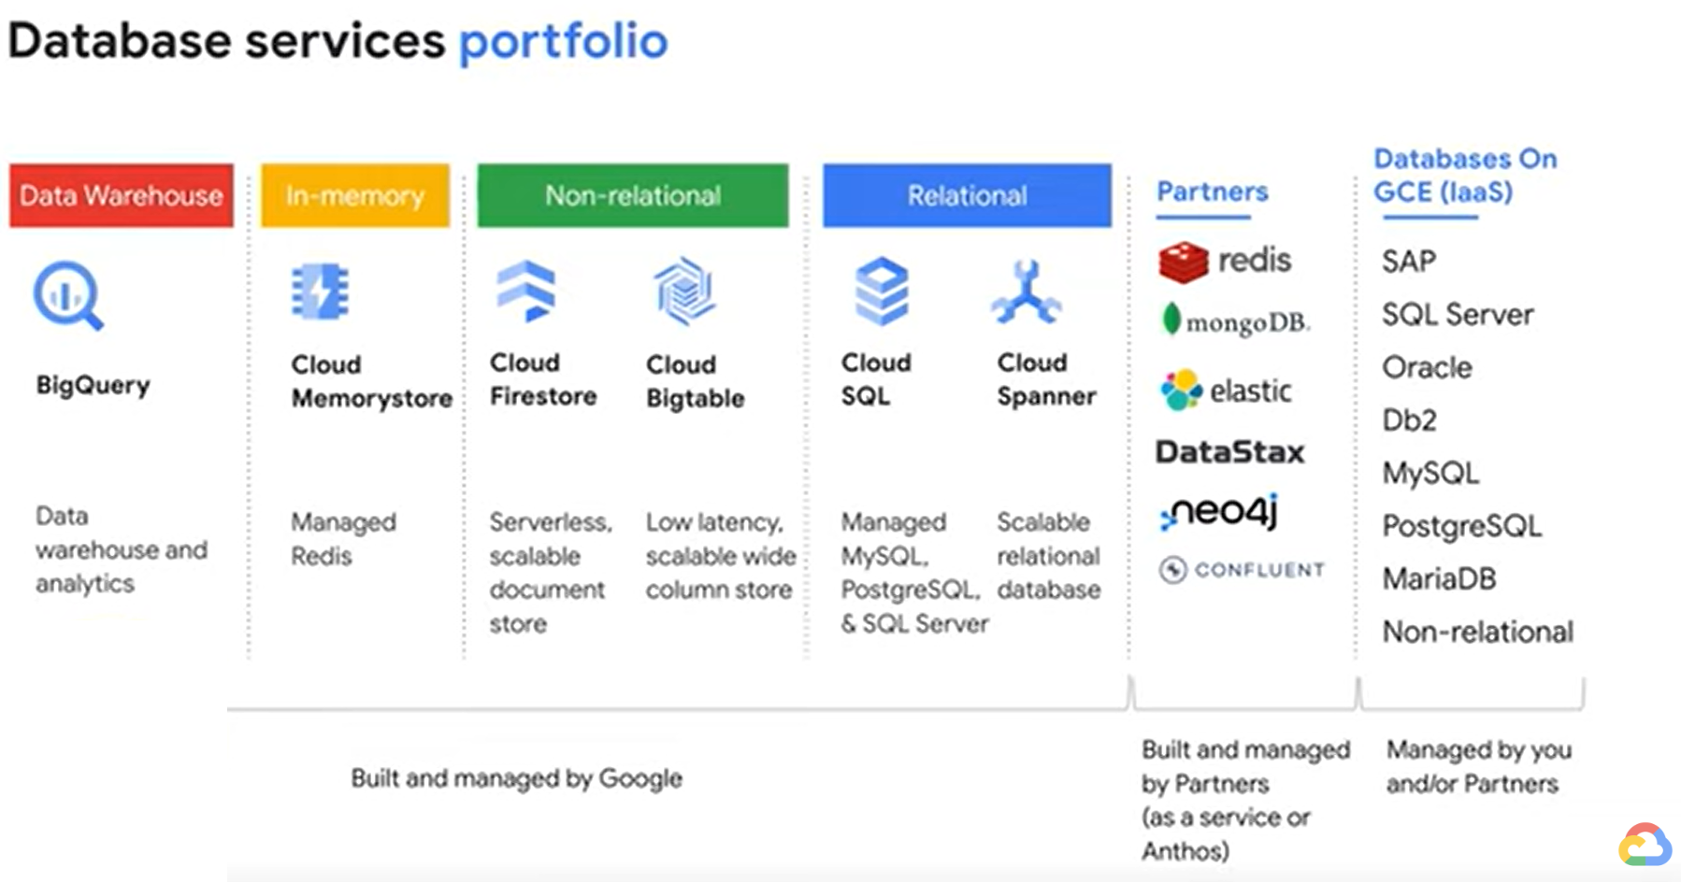
GCP Cloud SQL
Ref: https://www.youtube.com/watch?v=q6noaMAnk5s

Slide 10
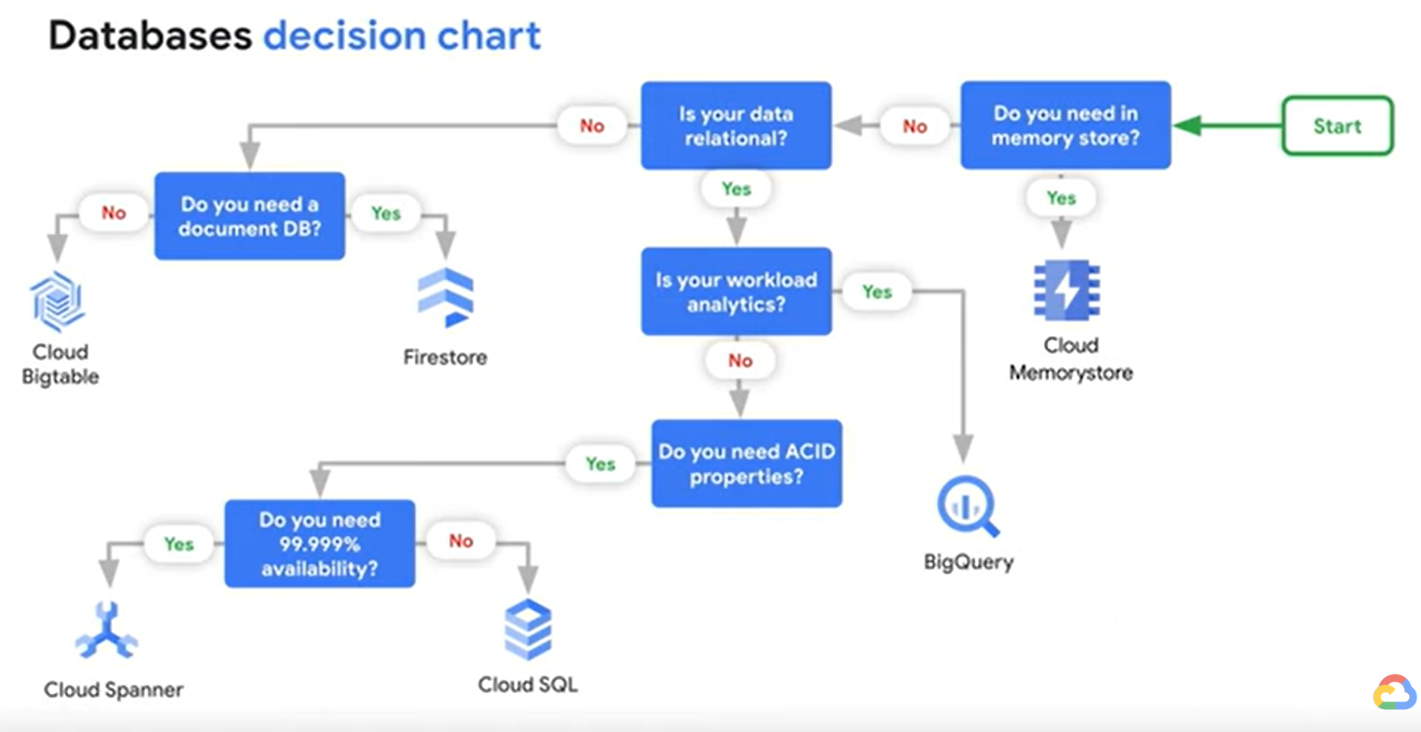
GCP Cloud SQL
Ref: https://www.youtube.com/watch?v=q6noaMAnk5s

Slide 11
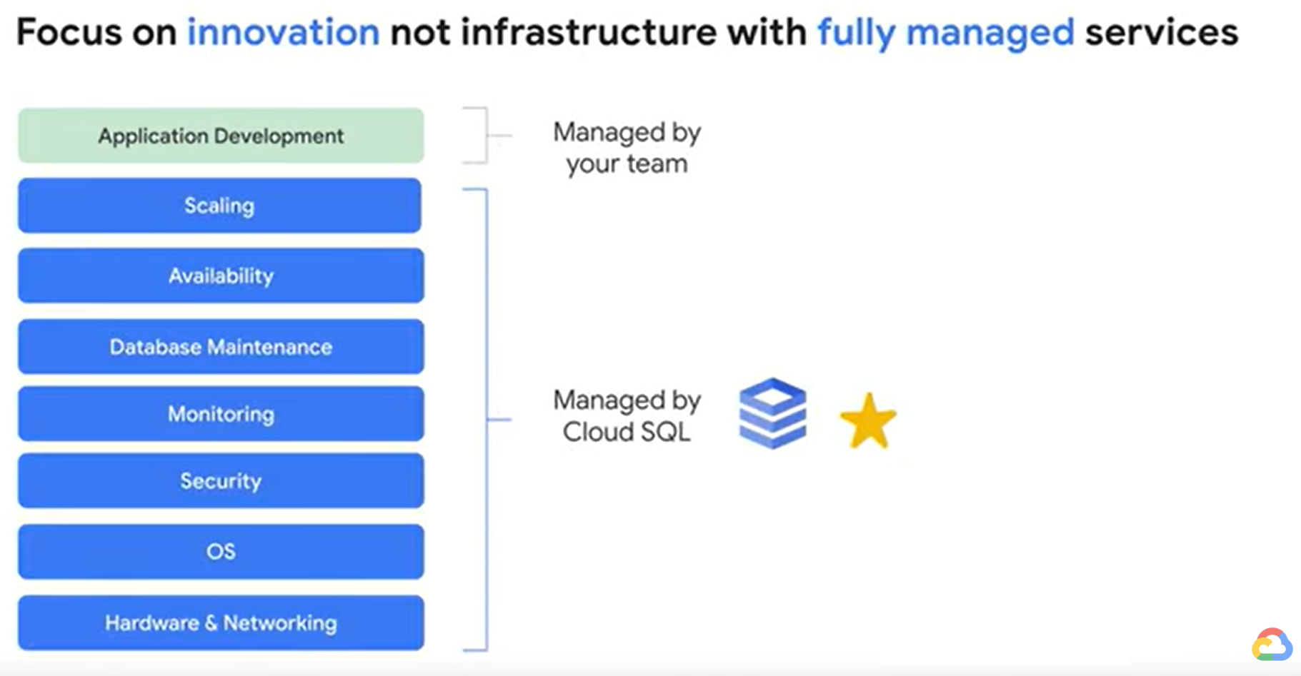
GCP Cloud SQL
Ref: https://www.youtube.com/watch?v=q6noaMAnk5s

Slide 12
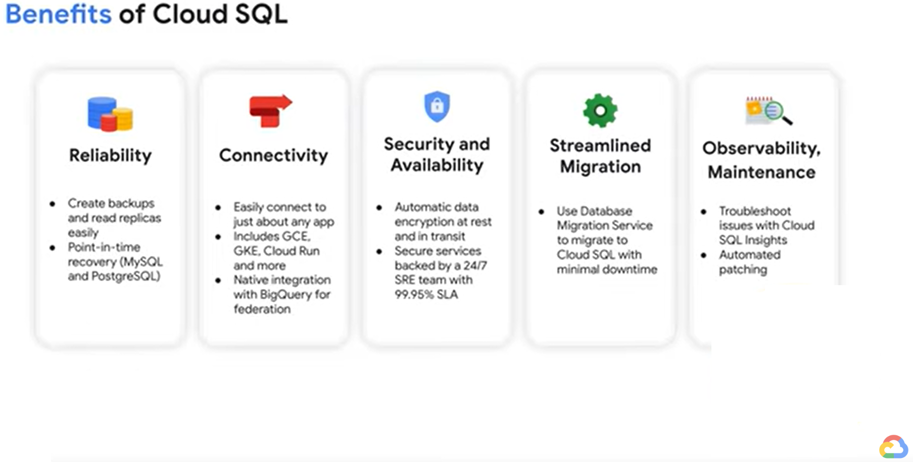
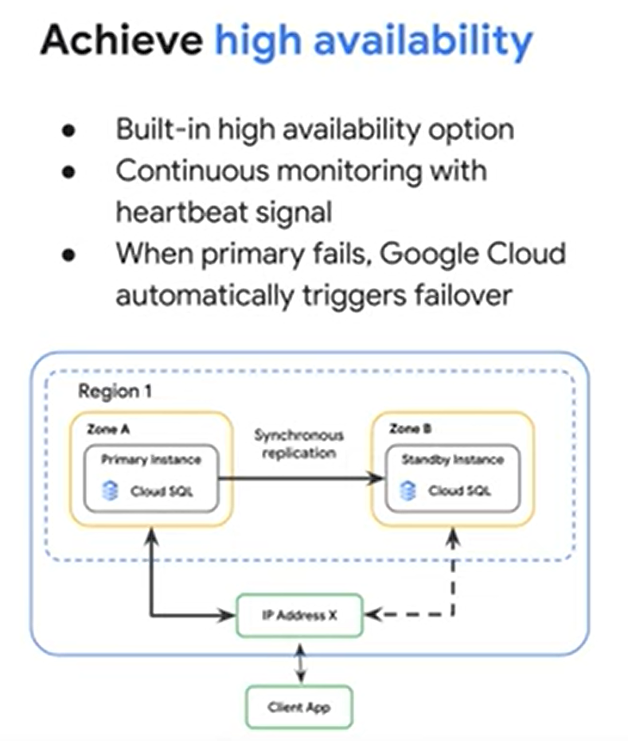
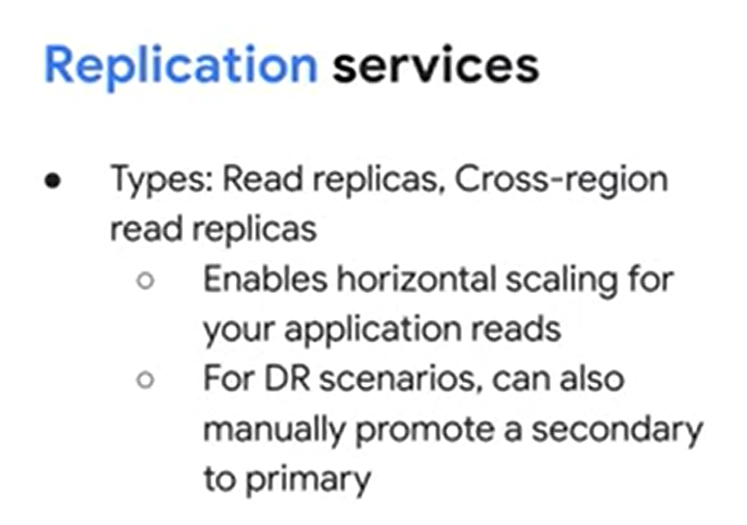
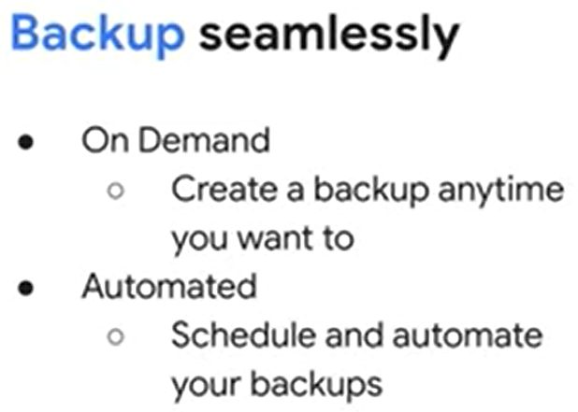
GCP Cloud SQL
Ref: https://www.youtube.com/watch?v=q6noaMAnk5s

Slide 13
GCP Cloud SQL
Database configurations with Cloud SQL
Create a Cloud SQL instance
Create database tables and import .sql data from Cloud Storage
Explore data with SQL statements
Connect to BigQuery Federated Queries and Data Studio
Connect to Compute Engine (GCE) using the Cloud SQL Auth proxy (previously called the Cloud SQL proxy)

Slide 14
GCP Cloud SQL
Database configurations with Cloud SQL
Create a Cloud SQL instance
Create database tables and import .sql data from Cloud Storage
Explore data with SQL statements
Connect to BigQuery Federated Queries and Data Studio
Connect to Compute Engine (GCE) using the Cloud SQL Auth proxy (previously called the Cloud SQL proxy)

Slide 15
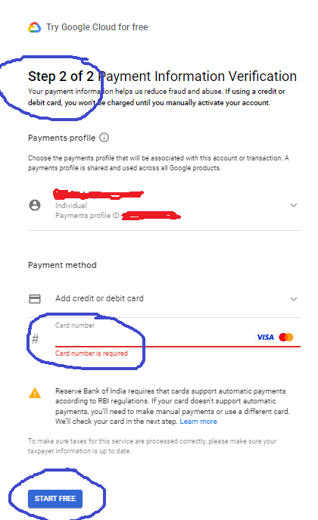
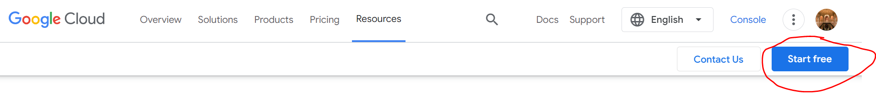
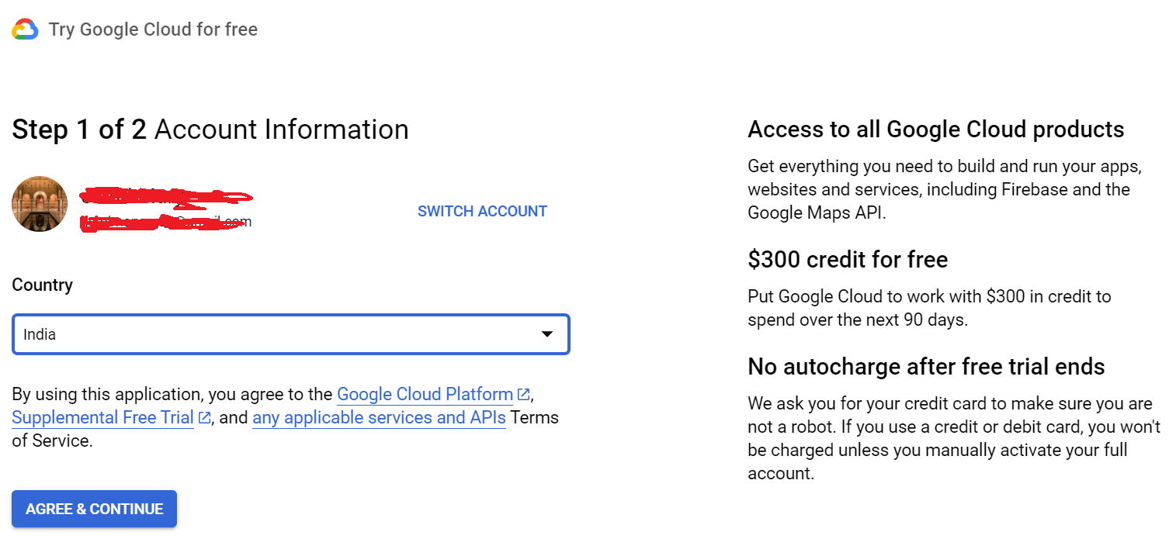
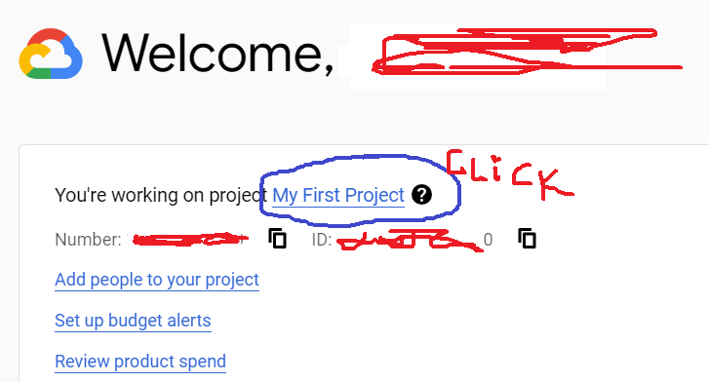
GCP Cloud SQL
Step1: create a Free Instance
https://cloud.google.com/free/?utm_source=google&utm_medium=cpc&utm_campaign=japac-IN-all-en-dr-BKWS-all-core-trial-EXA-dr-1605216&utm_content=text-ad-none-none-DEV_c-CRE_644159077391-ADGP_Hybrid+%7C+BKWS+-+EXA+%7C+Txt+~+GCP_General_core+brand_main-KWID_43700074766895886-aud-1596662389094:kwd-6458750523&userloc_9062061-network_g&utm_term=KW_google+cloud&gad_source=1&gclid=Cj0KCQiAnrOtBhDIARIsAFsSe50U3jot_YMOuqLpVsSh2NKxWEnnrQ6ti53tZgGZXmxDgU3GGkor2ToaAppoEALw_wcB&gclsrc=aw.ds&hl=en

Slide 16
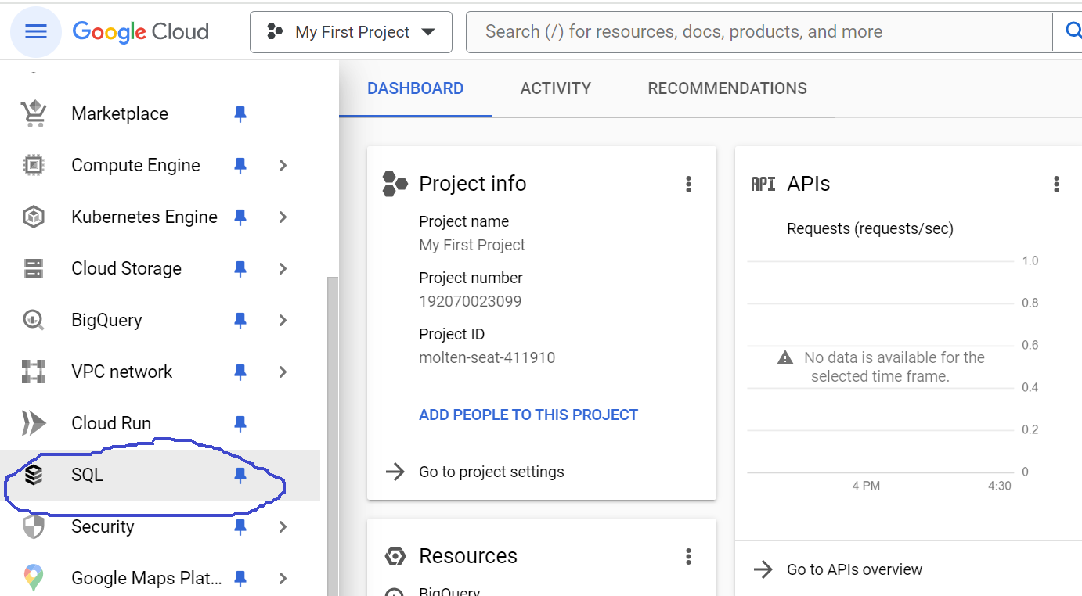
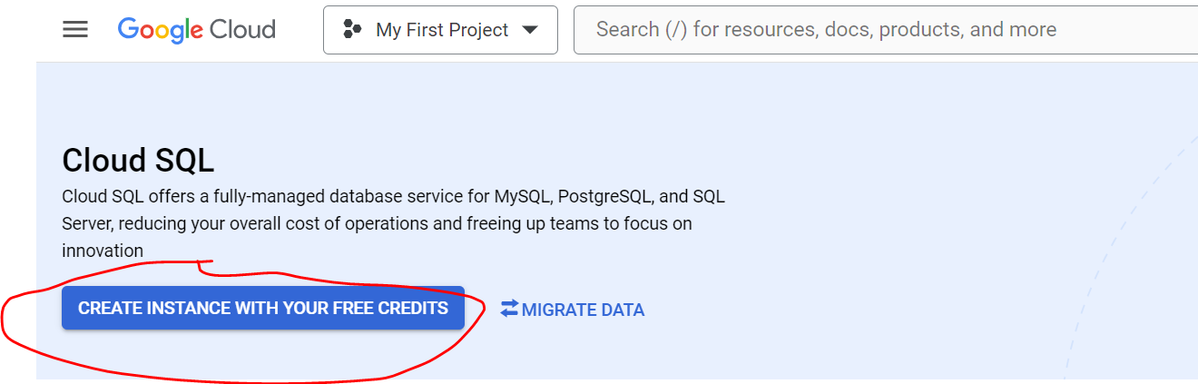
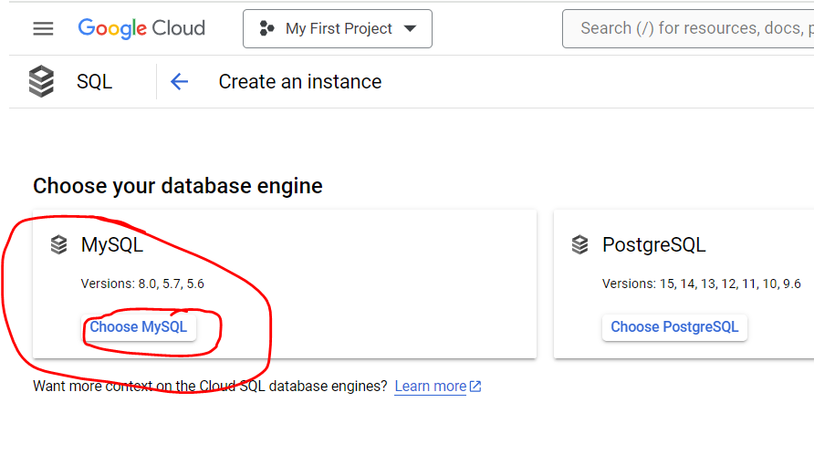
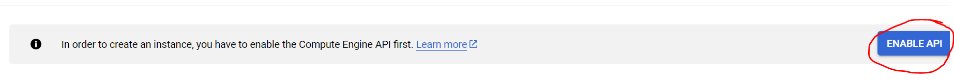
GCP Cloud SQL
Step2: Go to Console and Click SQL
Step3: Click ‘Create instance with your Free credits’
Step4: Click ‘Choose MySQL’
Step5: Enable API (if system prompts)

Slide 17
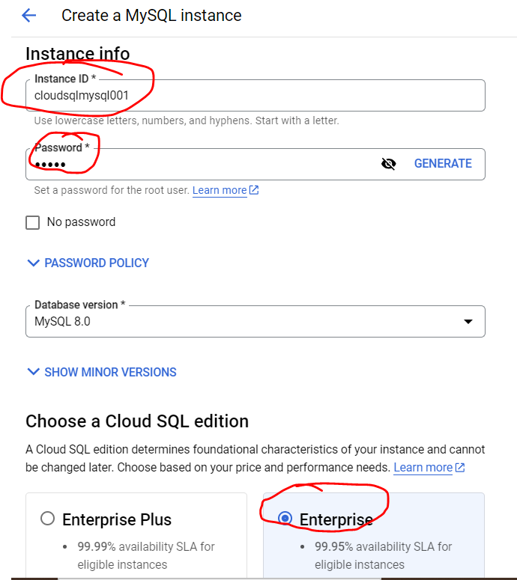
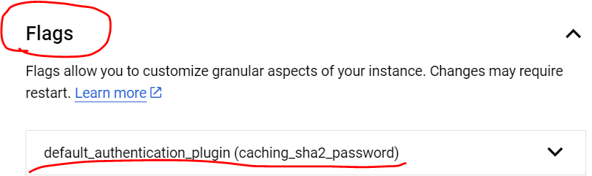
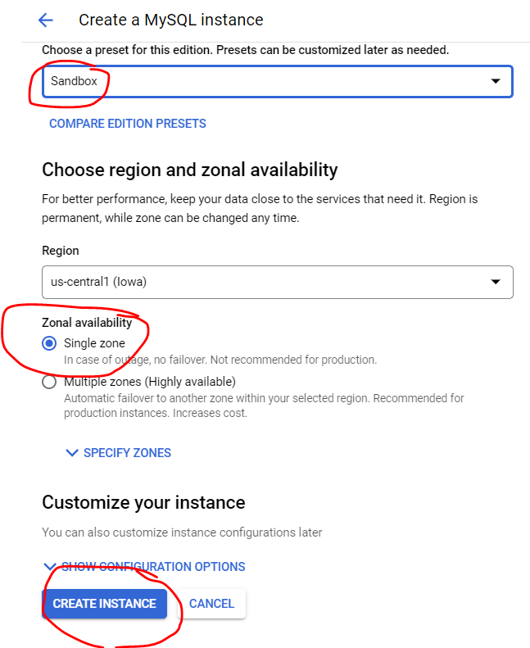
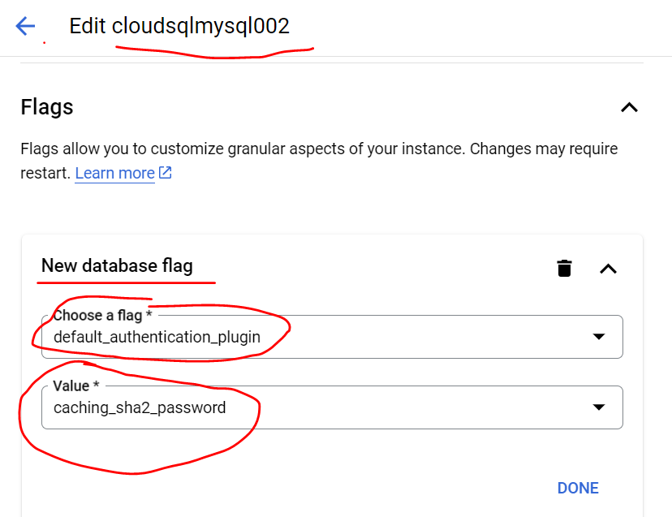
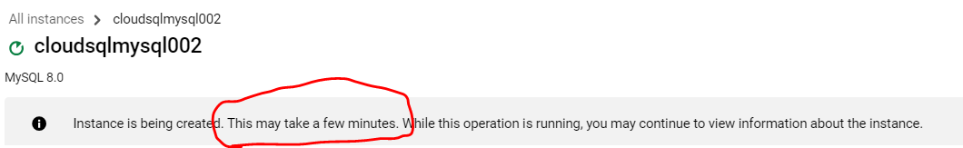
GCP Cloud SQL
STEP6: Create a MySQL instance > ‘Sandbox is chosen to lower the cost in pricing estimate

Slide 18
GCP Cloud SQL
Database configurations with Cloud SQL
Create a Cloud SQL instance
Create database tables and import .sql data from Cloud Storage
Explore data with SQL statements
Connect to BigQuery Federated Queries and Data Studio
Connect to Compute Engine (GCE) using the Cloud SQL Auth proxy (previously called the Cloud SQL proxy)

Slide 19
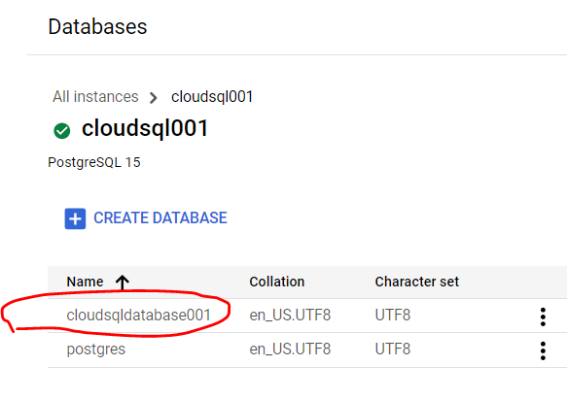
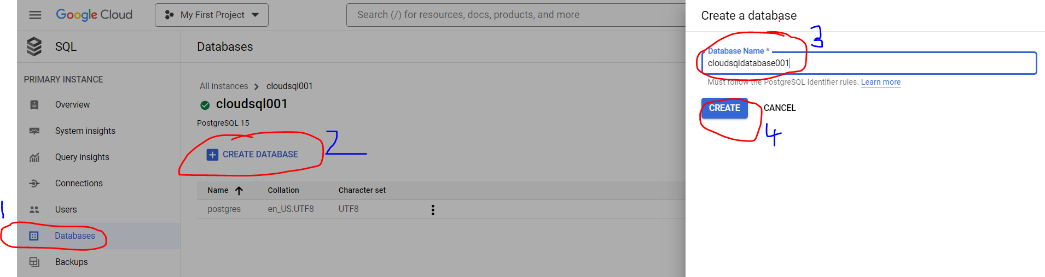
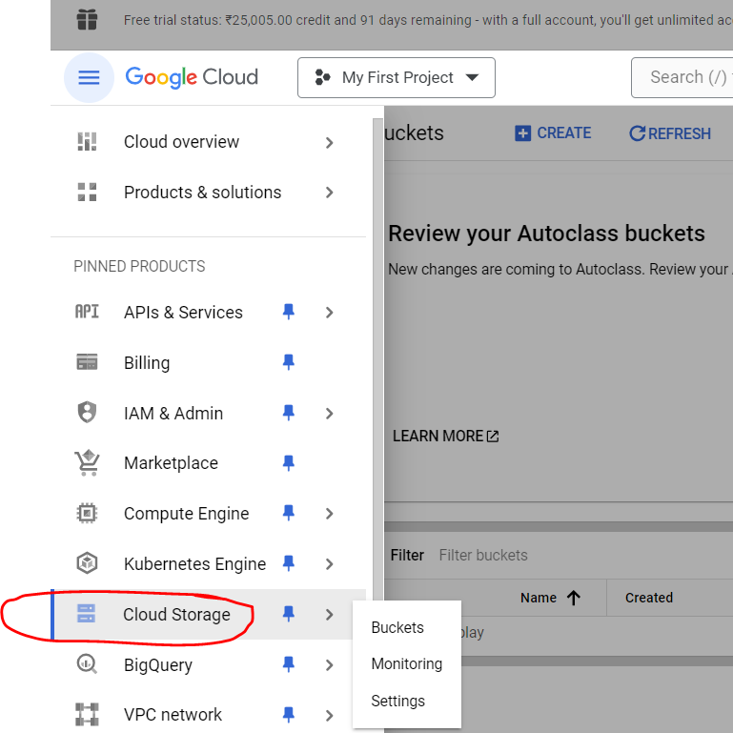
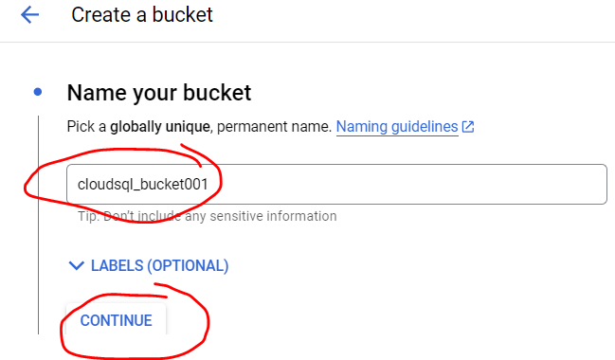
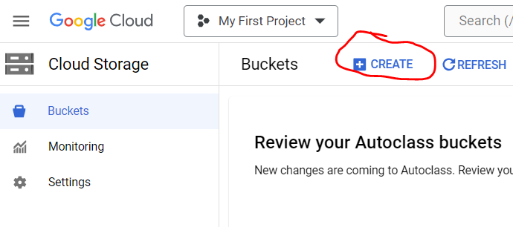
GCP Cloud SQL
STEP1: Create a Database
STEP2: Create a Cloud Storage and upload a .sql file

Slide 20
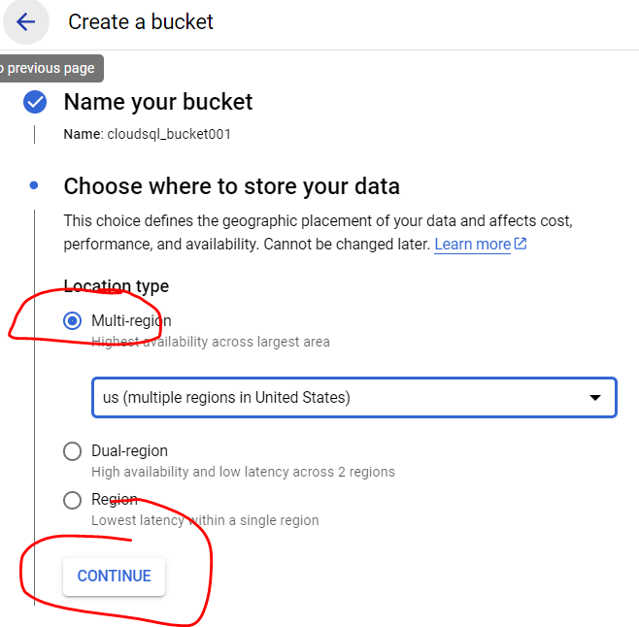
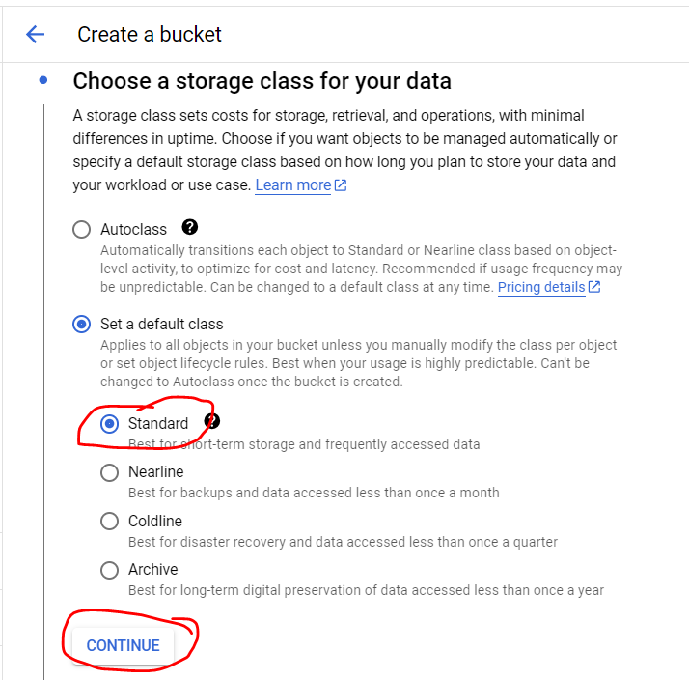
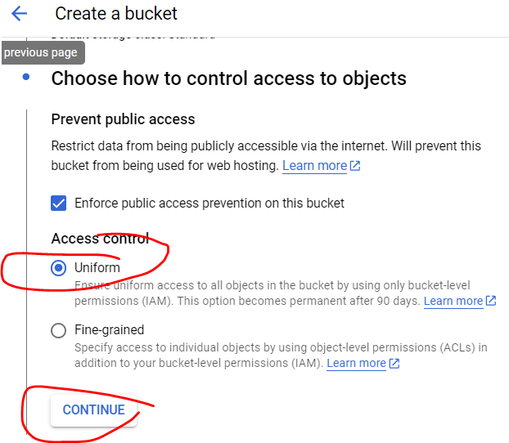
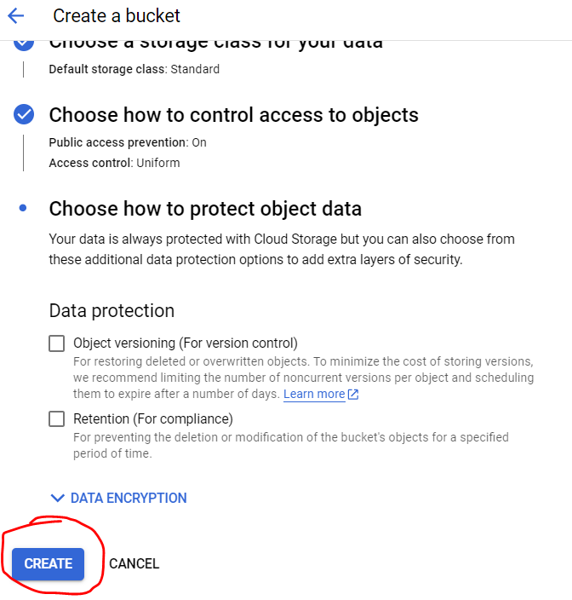
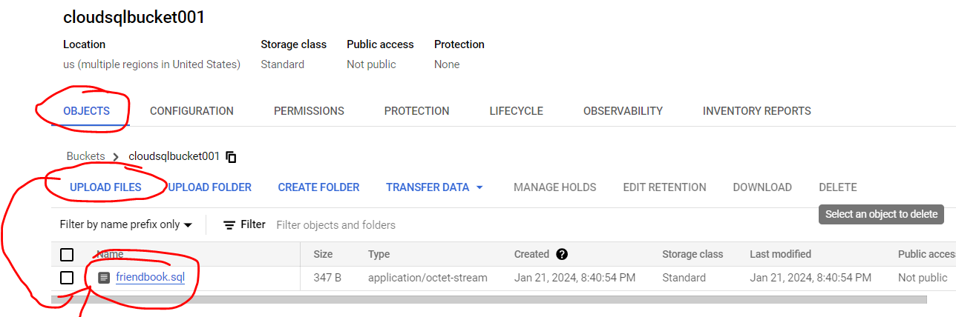
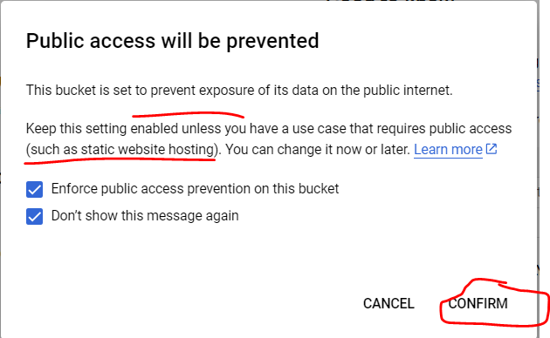
GCP Cloud SQL
STEP2: Create a Cloud Storage and upload a .sql file (Cont..)
Note: SQL data File to upload in GCP Bucket

Slide 21
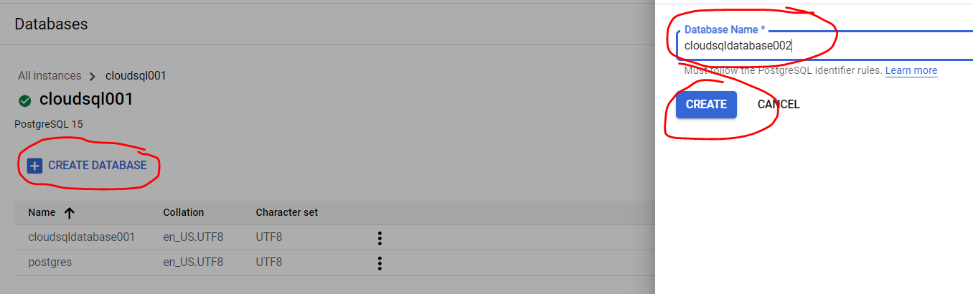
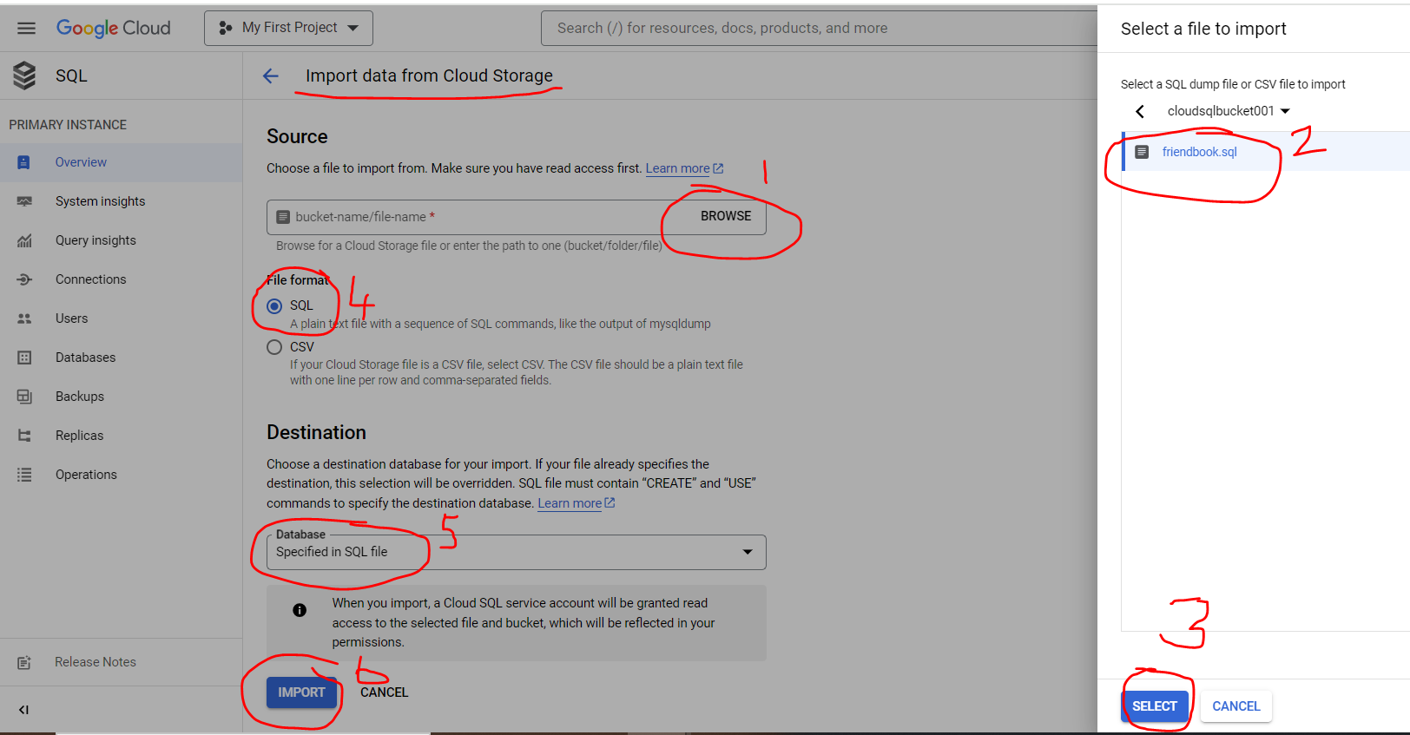
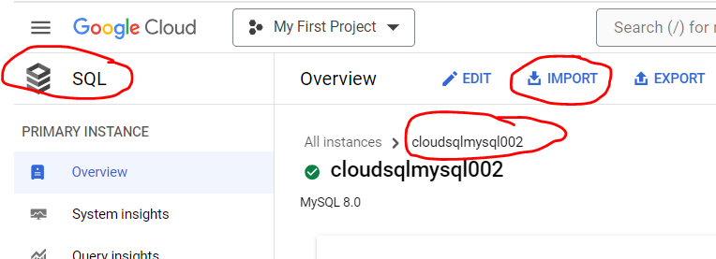
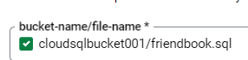
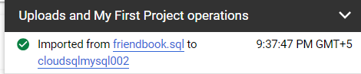
GCP Cloud SQL
Step3: Create a destination database
STEP4: Import data from Cloud Storage

Slide 22
GCP Cloud SQL
Database configurations with Cloud SQL
Create a Cloud SQL instance
Create database tables and import .sql data from Cloud Storage
Explore data with SQL statements
Connect to BigQuery Federated Queries and Data Studio
Connect to Compute Engine (GCE) using the Cloud SQL Auth proxy (previously called the Cloud SQL proxy)

Slide 23
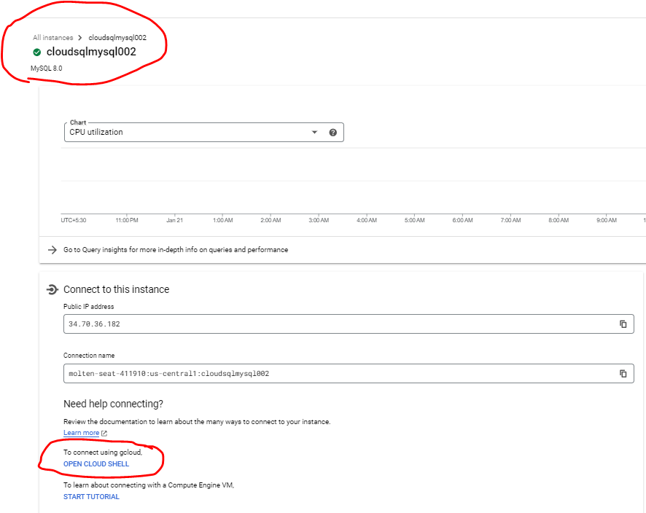
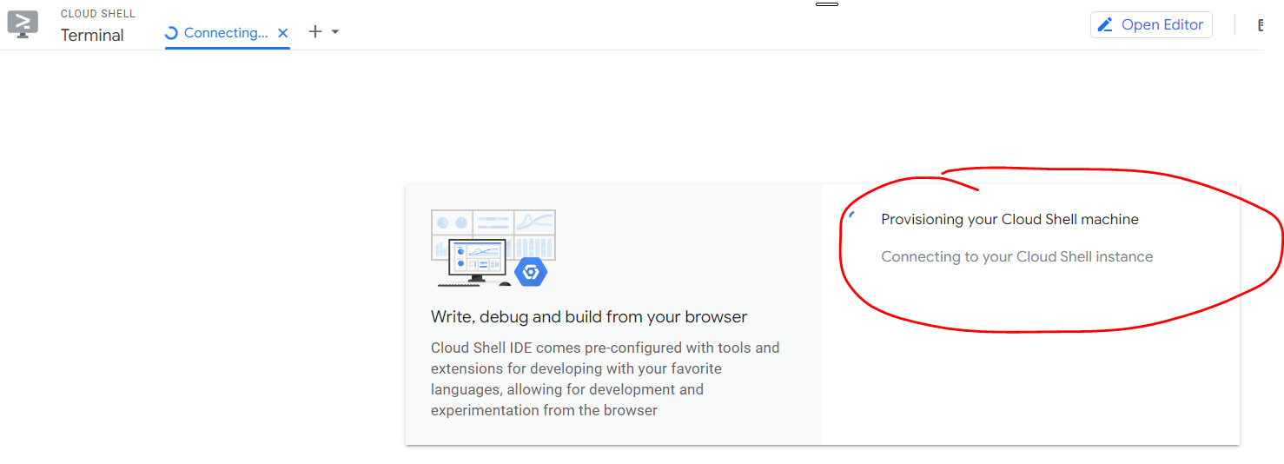
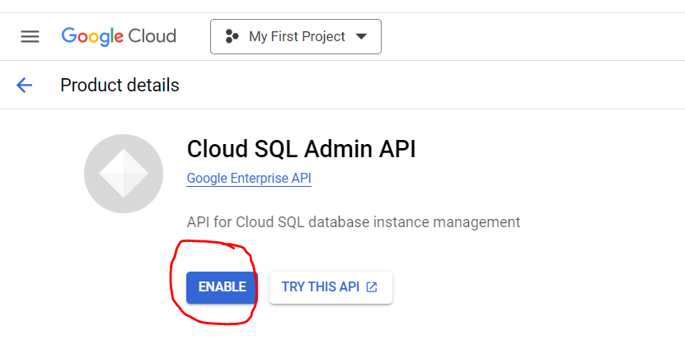
GCP Cloud SQL
Step1: Open Cloud Shell
Step2: Enable Cloud SQl Admin API
(if prompted by system)
https://console.cloud.google.com/apis/library/sqladmin.googleapis.com?project=molten-seat-411910

Slide 24
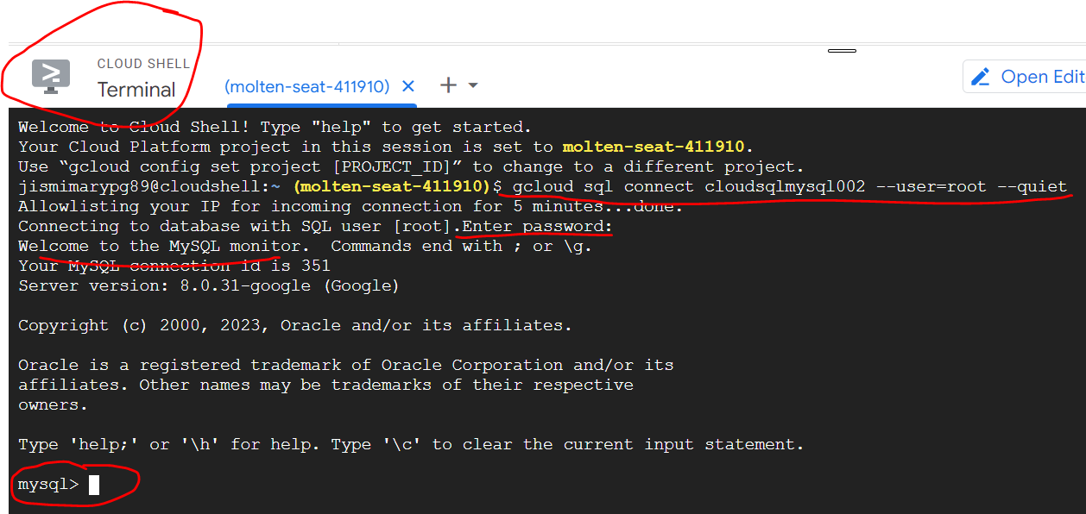
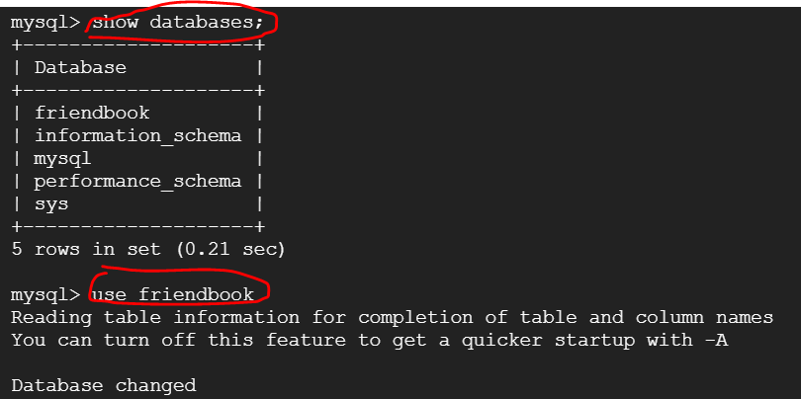
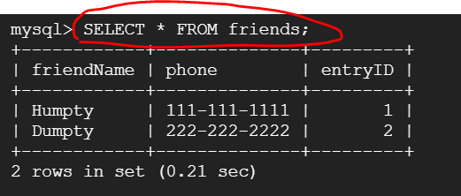
GCP Cloud SQL
Step3: Enter command to connect and authorize
$ gcloud sql connect cloudsqlmysql002 --user=root --quiet
Step4: Enter below commands
show databases;
use friendbook;
SELECT * FROM friends;
https://console.cloud.google.com/apis/library/sqladmin.googleapis.com?project=molten-seat-411910

Slide 25
GCP Cloud SQL
Database configurations with Cloud SQL
Create a Cloud SQL instance
Create database tables and import .sql data from Cloud Storage
Explore data with SQL statements
Connect to BigQuery Federated Queries and Data Studio
Connect to Compute Engine (GCE) using the Cloud SQL Auth proxy (previously called the Cloud SQL proxy)

Slide 26
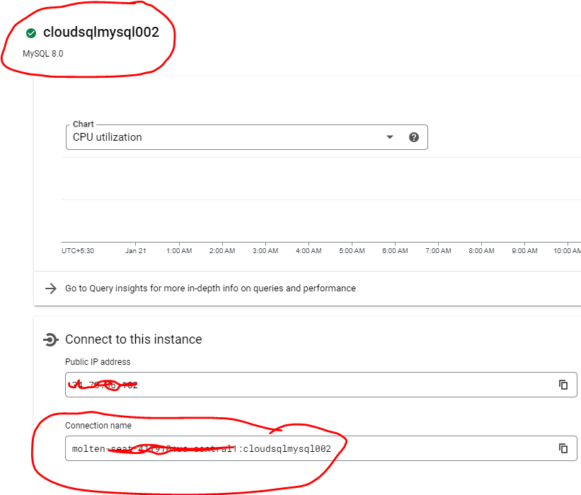
GCP Cloud SQL
Step1: Copy the CloudSQL Instance connection name
Cloud SQL connection name: molten-seat-xxxxxx:us-central1:cloudsqlmysql002
Database: friendbook
Username: root
Pwd: xxxx

Slide 27
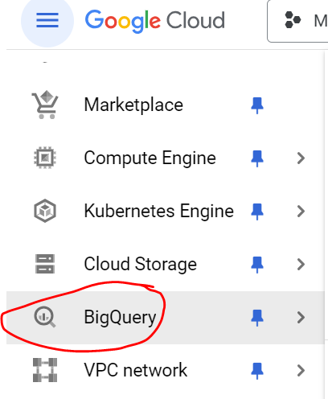
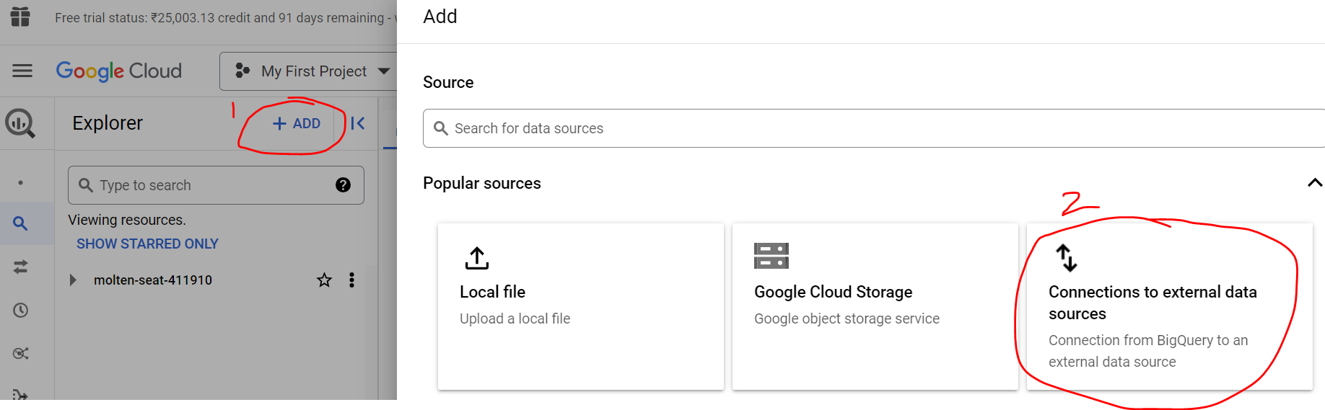
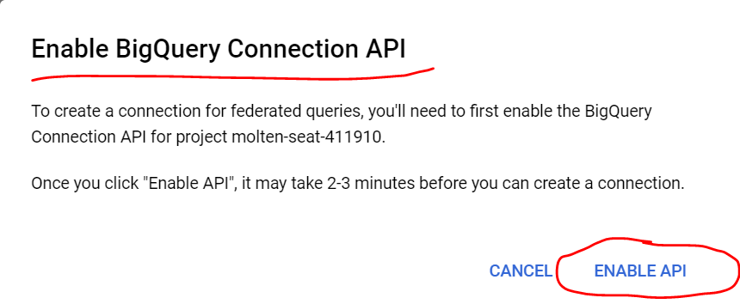
GCP Cloud SQL
Step2: Select BigQuery
Step3: Click ‘Add’ and click ‘Connections to external data sources’
Step4: Enable API (if system prompts)

Slide 28




GCP Cloud SQL
Step5: Enter the details in the popup and create connection
Bq_sql_connection
Fig: Click Go to connection
In the Connection info pane, copy the service account ID for use in a following step.

Slide 29




GCP Cloud SQL
Step6: Create SQL Query
SELECT * FROM EXTERNAL_QUERY("molten-seat-411910.us-central1.bq_sql_connection", "SELECT * FROM INFORMATION_SCHEMA.TABLES;");

Slide 30





GCP Cloud SQL
Looker Studio:
https://lookerstudio.google.com/u/0/navigation/reporting
c
Add IP: 142.251.74.0/23

Slide 31



GCP Cloud SQL
Looker Studio:
https://lookerstudio.google.com/u/0/navigation/reporting

Slide 32
GCP – Compute Engine
Ref: https://code.visualstudio.com/docs/python/python-tutorial#_create-a-virtual-environment

Slide 33

GCP Compute Engine Introduction

Slide 34
GCP Compute Engine Introduction
Compute Engine
Is a customizable compute service that lets you create and run virtual machines on Google’s infrastructure
You can create a Virtual Machine (VM) that fits your needs
Predefined machine types are pre-built and ready-to-go configurations of VMs with specific amounts of vCPU and memory to start running apps quickly
With Custom Machine Types, you can create virtual machines with the optimal amount of CPU and memory for your workloads
This allows you to tailor your infrastructure to your workload
If requirements change, using the stop/start feature you can move your workload to a smaller or larger Custom Machine Type instance, or to a predefined configuration
Machine types
In Compute Engine, machine types are grouped and curated by families for different workloads. You can choose from general-purpose, memory-optimized, compute-optimized and accelerator-optimized families.
General-purpose machines:
are used for Day-to-day computing at a lower cost and for balanced price/performance across a wide range of VM shapes
The use cases that best fit here are web serving, app serving, back office applications, databases, cache, media-streaming, microservices, virtual desktops, development environments
Memory-Optimized machine:
Are recommended for ultra high-memory workloads such as in-memory analytics and large in-memory databases such as SAP HANA
Compute-Optimized machines
Are recommended for ultra high performance workloads such as High Performance Computing (HPC), Electronic Design Automation (EDA), gaming, video transcoding, single-threaded applications
Accelerator-Optimized machines
Are optimized for high performance computing workloads such as Machine learning (ML), Massive parallelized computations and High Performance Computing (HPC)
How does it work?
You can create a VM instance using a boot disk image, a boot disk snapshot, or a container image
The image can be a public operating system (OS) image or a custom one
Depending on where your users are you can define the zone you want the virtual machine to be created in
By default all traffic from the internet is blocked by the firewall and you can enable the HTTP(s) traffic if needed
Use snapshot schedules (hourly, daily, or weekly) as a best practice to back up your Compute Engine workloads
Compute Engine offers live migration by default to keep your virtual machine instances running even when software or hardware update occurs
Your running instances are migrated to another host in the same zone instead of requiring your VMs to be rebooted
Ref: https://cloud.google.com/blog/topics/developers-practitioners/what-compute-engine-use-cases-security-pricing-and-more

Slide 35
GCP Compute Engine Introduction
Availability
For High Availability (HA) Compute Engine offers automatic failover to other regions or zones in event of a failure
Managed instance groups (MIGs) help keep the instances running by automatically replicating instances from a predefined image. They also provide application based autohealing health checks
If an application is not responding on a VM, the auto healer automatically recreates that VM for you
Regional MIGs let you spread app load across multiple zones
This replication protects against zonal failures
MIGs work with load balancing services to distribute traffic across all of the instances in the group
Compute Engine offers autoscaling to automatically add or remove VM instances from a managed instance group based on increases or decreases in load
Autoscaling lets your apps gracefully handle increases in traffic, and it reduces cost when the need for resources is lower
You define the autoscaling policy for automatic scaling based on the measured load, CPU utilization, requests per second or other metrics
Active Assist’s new feature, predictive autoscaling, helps improve response times for your applications–When you enable predictive autoscaling, Compute Engine forecasts future load based on your Managed Instance Group’s (MIG) history and scales it out in advance of predicted load, so that new instances are ready to serve when the load arrives
Without predictive autoscaling, an autoscaler can only scale a group reactively, based on observed changes in load in real time
With predictive autoscaling enabled, the autoscaler works with real-time data as well as with historical data to cover both the current and forecasted load
That makes predictive autoscaling ideal for those apps with long initialization times and whose workloads vary predictably with daily or weekly cycles
Security
Compute Engine provides you default hardware security. Using Identity and Access Management (IAM) you just have to ensure that proper permissions are given to control access to your VM resources
All the other basic security principles apply, if the resources are not related and don't require network communication amongst themselves, consider hosting them on different VPC networks
By default, users in a project can create persistent disks or copy images using any of the public images or any images that project members can access through IAM roles. You may want to restrict your project members so that they can create boot disks only from images that contain approved software that meet your policy or security requirements
You can define an organization policy that only allows Compute Engine VMs to be created from approved images
By default all VM families are Shielded VMs. Shielded VMs are virtual machine instances that are hardened with a set of easily configurable security features to ensure that when your VM boots, it’s running a verified bootloader and kernel — is the default for everyone using Compute Engine, at no additional charge
For additional security, you also have the option to use Confidential VM to encrypt your data in use, while it’s being processed in Compute Engine.
Use cases
running websites and databases
Migrate your existing systems onto Google Cloud, with Migrate for Compute Engine, enabling you to run stateful workloads in the cloud within minutes rather than days or weeks
Ref: https://cloud.google.com/blog/topics/developers-practitioners/what-compute-engine-use-cases-security-pricing-and-more

Slide 36
Security Groups
The Cloud Identity Groups API allows you to create and manage different types of groups, each of which supports different features, as well as their memberships.
The Cloud Identity Groups API only works with Google Groups for Business.
A group is a collection of entities, where each entity can be either another group or a user.
Google Groups
Google Groups have an email address and are frequently used as mailing lists. Google Groups can also be used across many Google products. For example. you can share a Google Doc with a group, invite a group to a Google Calendar event, or use a group for access management in IAM. A Google Group is the default group type.
Security groups
A security group is similar to a Google Group, but is used specifically for controlling access to organizational resources. A security group is created by updating a Google Group to a security group.
Warning: A security group cannot be changed back to a Google Group.
Group properties
Label: The label identifies the type of group:
Google Groups: cloudidentity.googleapis.com/groups.discussion_forum
Security groups: cloudidentity.googleapis.com/groups.security (this label is in addition to cloudidentity.googleapis.com/groups.discussion_forum, because security groups are based on Google Groups)
Entity key: An entity key is a human-readable unique identifier for the group:
Google Groups and security groups: the email address of the group
Parent: A parent is the resource to which the group belongs
Google Groups and security groups, the parent is the customer who owns the domain.
Display name: The display name is the name of the group as it appears in Google products.
Setups:
To setup google APIs:
https://cloud.google.com/identity/docs/how-to/setup
Creating security groups:
https://cloud.google.com/identity/docs/how-to/update-group-to-security-group#python

Slide 37


SSH into Compute Engine Instance
Compute Engine uses key-based SSH authentication to establish connections to all Linux virtual machine (VM) instances
You can optionally enable SSH for Windows VMs
By default, passwords aren't configured for local users on Linux VMs
Before you can connect to a VM, several configurations must be performed
If you use the Google Cloud console or the Google Cloud CLI to connect to your VMs, Compute Engine performs these configurations on your behalf
Compute Engine performs different configurations depending on which tool you use to connect and whether you manage access to VMs through metadata or OS Login
OS Login is available only for Linux VMs
Metadata-managed SSH connections
By default, Compute Engine uses custom project and/or instance metadata to configure SSH keys and to manage SSH access
All Windows VMs use metadata to manage SSH keys, while Linux VMs can use metadata keys or OS Login
If you use OS Login, metadata SSH keys are disabled.
Configurations Compute Engine performs before it grants SSH connections: when you use the Google Cloud console
You use the SSH button in the Google Cloud console to connect to your VM
Compute Engine sets a username and creates an ephemeral SSH key pair with the following configuration:
Your username is set as the username in your Google Account. For example, if the email address associated with your Google Account is cloudysanfrancisco@gmail.com, then your username is cloudysanfrancisco.
Note: You can override the default username by clicking the settings gear icon and selecting Change Linux Username when you connect to the VM
Your public and private SSH keys are stored in your browser session
Your SSH key has an expiry of five minutes. Five minutes after Compute Engine creates the key, you can't use the SSH key to connect to the VM anymore.
Compute Engine uploads the public SSH key and username to metadata
Compute Engine retrieves the SSH key and username from metadata, creates a user account with the username, and on Linux VMs, stores the public key in your user's ~/.ssh/authorized_keys file on the VM. On Windows VMs, Compute Engine doesn't store the public key on the VM.
Compute Engine grants your connection.
Ref: https://cloud.google.com/compute/docs/instances/ssh#console

Slide 38
GCP Compute Engine Machine Images
Machine image
Is a Compute Engine resource that stores all the configuration, metadata, permissions, and data from multiple disks of a virtual machine (VM) instance
You can use a machine image in many system maintenance, backup and recovery, and instance cloning scenarios
When to use a machine image
Single disk backup, Multiple disk backup, Differential backup, Instance cloning
Multiple Disk backups
Machine images support backups at the VM instance level. Disks are backed up as differential snapshots.
When a machine image is used to copy disks, Compute Engine guarantees that the data across disks is captured in a crash-consistent manner at a given time. Compute Engine uses globally consistent timestamps to ensure this guarantee. This consistency is critical if your VM instance is running and you want to ensure that the backup point across disks is maintained. When the backup point across disks is maintained, you can return to the same point in time across disks when you restore a machine image.
Note: This consistency guarantee only applies at the I/O operation level or crash level. This guarantee isn't applied at the application level. Consistency guarantees at the application level would require OS and application participation.
Multiple disk backup
Machine images are suitable for creating backups of all disks that are attached to a VM instance. A machine image can be used to backup multiple disks at a time. A persistent disk snapshot can only backup a single disk at a time.
Differential disk backup
Machine images store differential snapshots of your previously created machine images or snapshots. When you generate a machine image from a VM instance, the first machine image contains a full copy of all disk data. Subsequent machine images are stored as differential copies for better performance and space efficiency. This mechanism is similar to that used by persistent disk snapshots.
Instance cloning
Machine images can be used to clone instances. You can use machine image to make copies of an instance that contains most of the VM configurations of the source instance. These copies can then be used for troubleshooting, scaling VM instances, debugging, or system maintenance.
Information stored in a machine image
A machine image collects the following information from the source instance:
VM instance configuration. Each VM configuration includes the following properties:
Description, Machine type, Instance metadata, Labels, Network tags, Maintenance policy, If applicable, Unified Extensible Firmware Interface (UEFI) variables
The volume mapping used to create persistent disks and local SSDs for the source instance.
Data stored on persistent disks at consistent points in time across disks.
The following information from the source instance is not collected by a machine image:
Data in memory, Data in local SSD. However, a machine image captures the device mapping of local SSDs, Attributes that are specific to the source instance, such as the name or IP address.

Slide 39



GCP Compute Engine Machine Images
Machine image storage location
To meet compliance needs, you might need to control where your data is stored. You can control where your machine image is stored geographically by specifying a storageLocation during the creation of your machine image. Machine images can be stored in a Cloud Storage multi-region, such as asia, a Cloud Storage dual-region, such as asia1, or a Cloud Storage region, such as asia-south1
By default, when creating a machine image from an instance, the machine image is stored in either the Cloud Storage multi-region bucket that contains the source instance, or the geographically closest Cloud Storage multi-region bucket to the source instance
For example, if your source instance is stored in us-central1 your machine image is stored in the us multi-region by default. However, a default location like australia-southeast1 is outside of a multi-region. The closest multi-region is asia
Regardless of where the machine image is stored, you can still access the machine image globally by setting the proper permissions

Slide 40
Persistent Disk
By default, each Compute Engine virtual machine (VM) instance has a single boot Persistent Disk volume that contains the operating system
When your apps require additional storage space, one possible solution is to attach additional Persistent Disk volumes to your VM
Persistent Disk volumes are durable network storage devices that your VMs can access like physical disks in a desktop or a server. The data on each persistent disk is distributed across several physical disks. Compute Engine manages the physical disks and the data distribution for you to ensure redundancy and optimal performance
Persistent Disk volumes are located independently from your VMs, so you can detach or move the volumes to keep your data even after you delete your instances
Persistent Disk performance scales automatically with size, so you can resize your existing Persistent Disk volumes or add more Persistent Disk volumes to a VM to meet your performance and storage space requirements
Add a non-boot disk to your VM when you need reliable and affordable storage with consistent performance characteristics
Ref: https://cloud.google.com/compute/docs/disks; https://cloud.google.com/compute/docs/disks/persistent-disks

Slide 41
Autoscaling and MIGs
Autoscaling is a feature of managed instance groups (MIGs).
A managed instance group (MIG) is a collection of virtual machine (VM) instances that are created from a common instance template
An autoscaler adds or deletes instances from a managed instance group based on the group's autoscaling policy
Although Compute Engine has both managed and unmanaged instance groups, only managed instance groups can be used with an autoscaler
Autoscaling policy
When you define an autoscaling policy for your group, you specify one or more signals that the autoscaler uses to scale the group
When you set multiple signals in a policy, the autoscaler calculates the recommended number of VMs for each signal and sets your group's recommended size to the largest number
An autoscaling policy must always have at least one scaling signal
When you turn on autoscaling in a MIG, by default, the autoscaler adds a CPU utilization signal
You can edit this default signal, or remove and add other signals in the policy
Target utilization metrics - You can autoscale based on one or more of the following metrics that reflect the load of the instance group:
Average CPU utilization
HTTP load balancing serving capacity
Cloud Monitoring metrics
Schedules - You can use schedule-based autoscaling to allocate capacity for anticipated loads. You can have up to 128 scaling schedules per instance group. For each scaling schedule, specify the following:
Capacity: minimum required VM instances
Schedule: start time, duration, and recurrence (for example, once, daily, weekly, or monthly)
Initialization period
The initialization period, formerly known as cool down period, is the duration it takes for applications to initialize on your VM instances.
Stabilization period
Autoscaling signals like CPU utilization are not very stable and can change rapidly. As the load goes up and down, the autoscaler needs to stabilize the signal to avoid continuous VM deletion and creation. The autoscaler stabilizes a signal by keeping sufficient VM capacity in order to serve the peak load that is observed during the stabilization period.
Predictive autoscaling
If you enable predictive autoscaling to optimize your MIG for availability, the autoscaler forecasts future load based on historical data and scales out a MIG in advance of predicted load, so that new instances are ready to serve when the load arrives.
Scale-in controls
If your workloads take many minutes to initialize (for example, due to lengthy installation tasks), you can reduce the risk of response latency caused by abrupt scale-in events by configuring scale-in controls.

Slide 42






Autoscaling and MIGs
Create a MIG with VMs in multiple zones in a region - Use the Google Cloud console

Slide 43
GCP - Google Cloud Storage (GCS)
Ref: https://code.visualstudio.com/docs/python/python-tutorial#_create-a-virtual-environment

Slide 44
GCP GCS Introduction
Cloud Storage
Is a service for storing your objects in Google Cloud
An object is an immutable piece of data consisting of a file of any format
You store objects in containers called buckets
Buckets can also contain managed folders, which you use to provide expanded access to groups of objects with a shared name prefix
All buckets are associated with a project, and you can group your projects under an organization
Each project, bucket, managed folder, and object in Google Cloud is a resource in Google Cloud, as are things such as Compute Engine instances
After you create a project, you can create Cloud Storage buckets, upload objects to your buckets, and download objects from your buckets
You can also grant permissions to make your data accessible to principals you specify, or - for certain use cases such as hosting a website - accessible to everyone on the public internet
The Google Cloud hierarchy - Here's how the Cloud Storage structure can apply to a real-world case:
Organization: Your company, called Example Inc., creates a Google Cloud organization called exampleinc.org.
Project: Example Inc. is building several applications, and each one is associated with a project. Each project has its own set of Cloud Storage APIs, as well as other resources.
Bucket: Each project can contain multiple buckets, which are containers to store your objects. For example, you might create a photos bucket for all the image files your app generates and a separate videos bucket.
Object: Each bucket can contain essentially unlimited individual objects, such as an image called puppy.png.
Managed folder: Each bucket can also contain multiple managed folders, which grant additional access beyond the access granted to the overall bucket. This additional access applies to objects that have a prefix matching the managed folder name. For example, you might create an animals/ managed folder, which gives designated users additional access to objects such as animals/puppy.png and animals/kitten.png.
Basic tools for Cloud Storage - Here are some basic ways you can interact with Cloud Storage:
Console: The Google Cloud console provides a visual interface for you to manage your data in a browser.
Google Cloud CLI: The gcloud CLI allows you to interact with Cloud Storage through a terminal using gcloud storage commands.
Client libraries: The Cloud Storage client libraries allow you to manage your data using one of your preferred languages, including C++, C#, Go, Java, Node.js, PHP, Python, and Ruby.
REST APIs: Manage your data using the JSON or XML API.
Terraform: Terraform is an infrastructure-as-code (IaC) tool that you can use to provision the infrastructure for Cloud Storage.
Cloud Storage FUSE: Cloud Storage FUSE lets you mount Cloud Storage buckets to your local file system. This enables your applications to read from a bucket or write to a bucket by using standard file system semantics.
Securing your data - Once you upload your objects to Cloud Storage, you have fine-grained control over how you secure and share your data. Here are some ways to secure the data you upload to Cloud Storage:
Identity and Access Management: Use IAM to control who has access to the resources in your Google Cloud project. Resources include Cloud Storage buckets and objects, as well as other Google Cloud entities such as Compute Engine instances. You can grant principals certain types of access to buckets and objects, such as update, create, or delete.
Data encryption: Cloud Storage uses server-side encryption to encrypt your data by default. You can also use supplemental data encryption options such as customer-managed encryption keys and customer-supplied encryption keys.
Authentication: Ensure that anyone who accesses your data has proper credentials.
Bucket Lock: Govern how long objects in buckets must be retained by specifying a retention policy.
Object Versioning: When a live version of an object is replaced or deleted, it can be retained as a noncurrent version if you enable Object Versioning.

Slide 45



GCS bucket Configuration
Required roles
To create a Cloud Storage bucket, need the Storage Admin (roles/storage.admin) IAM role for the project
Create a new bucket
Ref: https://cloud.google.com/storage/docs/creating-buckets

Slide 46



Hosting Static Sites on GCS (http site)
Configure a Cloud Storage bucket to host a static website for a domain you own
Static web pages can contain client-side technologies such as HTML, CSS, and JavaScript
They cannot contain dynamic content such as server-side scripts like PHP.
Caution: This tutorial makes content available to the public internet. We recommend that you don't serve content that contains sensitive or private data from your Cloud Storage bucket
Objectives
Point your domain to Cloud Storage by using a CNAME record.
Create a bucket that is linked to your domain.
Upload and share your site's files.
Test the website.
Static website examples
Index pages (file served to visitors when they request a URL that doesn't have an associated file)
Error page (file returned to visitors of your static site who request a URL that does not correspond to an existing file.)
Create a google cloud project:
In the Google Cloud console, on the project selector page, select or create a Google Cloud project.
https://console.cloud.google.com/projectselector2/home/dashboard?_ga=2.73235859.1830486543.1706076318-767419507.1704281272
Note: If you don't plan to keep the resources that you create in this procedure, create a project instead of selecting an existing project. After you finish these steps, you can delete the project, removing all resources associated with the project.
Ref:
http site: https://cloud.google.com/storage/docs/hosting-static-website-http
https site: https://cloud.google.com/storage/docs/hosting-static-website

Slide 47


Hosting Static Sites on GCS (http site)
Prerequisites:
Make sure that billing is enabled for your Google Cloud project
If the project is linked to a Cloud Billing account, and if you have only one Cloud Billing account, the Billing Overview page is displayed.
Have a domain that you own or manage
If you don't have an existing domain, there are many services through which you can register a new domain
Verify that you own or manage the domain that you will be using
Make sure you are verifying the top-level domain, such as example.com, and not a subdomain, such as www.example.com
To verify domain ownership:
Open Search Console. You must be signed in with the Google account that you will use to manage ownership of your domain.
https://search.google.com/search-console/welcome
Ref:
http site: https://cloud.google.com/storage/docs/hosting-static-website-http
https site: https://cloud.google.com/storage/docs/hosting-static-website

Slide 48






Hosting Static Sites on GCS (http site)
https://support.google.com/a/topic/1409901?sjid=18320093801883752636-AP
https://hpanel.hostinger.com/domain/jmpg.tech/dns
Ref: https://www.youtube.com/watch?v=C_0FSgVgqnc

Slide 49





Hosting Static Sites on GCS (http site)
Ref:
http site: https://cloud.google.com/storage/docs/hosting-static-website-http
https site: https://cloud.google.com/storage/docs/hosting-static-website

Slide 50




Hosting Static Sites on GCS (http site)
Connecting your domain to Cloud Storage
To connect your domain to Cloud Storage, create a CNAME record through your domain registration service
A CNAME record is a type of DNS record. It directs traffic that requests a URL from your domain to the resources you want to serve, in this case objects in your Cloud Storage buckets
Create a bucket whose name matches the CNAME you created for your domain
For example, if you added a CNAME record pointing from the www subdomain of example.com to c.storage.googleapis.com., then create a bucket with the name "www.example.com".
Ref:
http site: https://cloud.google.com/storage/docs/hosting-static-website-http
https site: https://cloud.google.com/storage/docs/hosting-static-website

Slide 51



Hosting Static Sites on GCS (http site)
Uploading your site's files:
Add to your bucket the files you want your website to serve:
After the upload completes, you should see the file name along with file information displayed in the bucket.
Ref:
http site: https://cloud.google.com/storage/docs/hosting-static-website-http
https site: https://cloud.google.com/storage/docs/hosting-static-website

Slide 52





Hosting Static Sites on GCS (http site)
Sharing your files
Make all objects in a bucket readable to everyone on the public internet:
Caution: Before making your bucket publicly accessible, make sure that the files in your bucket do not contain sensitive or private information.
Once shared publicly, a link icon appears for each object in the public access column. You can click this icon to get the URL for the object.
Note: roles/storage.objectViewer includes permission to list the objects in the bucket. If you don't want to grant listing publicly, use roles/storage.legacyObjectReader
Ref:
http site: https://cloud.google.com/storage/docs/hosting-static-website-http
https site: https://cloud.google.com/storage/docs/hosting-static-website

Slide 53


Hosting Static Sites on GCS (http site)
Recommended: Assigning specialty pages
You can assign an index page suffix, which is controlled by the MainPageSuffix property and a custom error page, which is controlled by the NotFoundPage property. Assigning either is optional, but without an index page, nothing is served when users access your top-level site, for example, http://www.jmpg.tech
In the following sample, the MainPageSuffix is set to index.html and NotFoundPage is set to 404.html:
Test the website
Ref:
http site: https://cloud.google.com/storage/docs/hosting-static-website-http
https site: https://cloud.google.com/storage/docs/hosting-static-website

Slide 54
Appendix
Ref: https://code.visualstudio.com/docs/python/python-tutorial#_create-a-virtual-environment

Slide 55
GCP Cloud SQL
Database configurations with Cloud SQL
Create a Cloud SQL instance
Create database tables and import .sql data from Cloud Storage
Explore data with SQL statements
Connect to BigQuery Federated Queries and Data Studio
Connect to Compute Engine (GCE) using the Cloud SQL Auth proxy (previously called the Cloud SQL proxy)

Slide 56



GCP Cloud SQL
Click Google ‘compute engine’

Slide 57



GCP Cloud SQL
Run the command: to update the APT package manager and install wget
sudo apt-get install wget
Run the command: to download and install the cloud SQL Auth proxy on our server
wget https://dl.google.com/cloudsql/cloud_sql_proxy.linux.amd64 -O cloud_sql_proxy
gcloud sql instances describe cloudsqlmysql002
Run the command: to make the cloud SQL auth proxy executable
chmod +x cloud_sql_proxy
Run the command: to Install Mysql Client
sudo apt-get install mysql-client

Slide 58
GCP GCS Introduction
https://cloud.google.com/storage/docs/creating-buckets
https://8grams.medium.com/gcp-101-google-cloud-storage-30471c98edbb
https://k21academy.com/google-cloud/google-cloud-storage/
https://cloud.google.com/storage/docs/introduction
https://cloud.google.com/storage?hl=en#business-case
https://www.geeksforgeeks.org/cloud-storage-in-google-cloud-platform-gcp/
https://docs.hevodata.com/sources/dbfs/file-storage/google-cloud-storage-(gcs)/#:~:text=Google%20Cloud%20Storage%20(GCS)%20is,warehouse%2C%20and%20running%20analytical%20processes.
Ref: https://cloud.google.com/sql?hl=en; https://www.youtube.com/watch?v=ZMQ2n6i-7jw; https://cloud.google.com/sql/docs/introduction; https://www.youtube.com/watch?v=q6noaMAnk5s;

